Slide 1
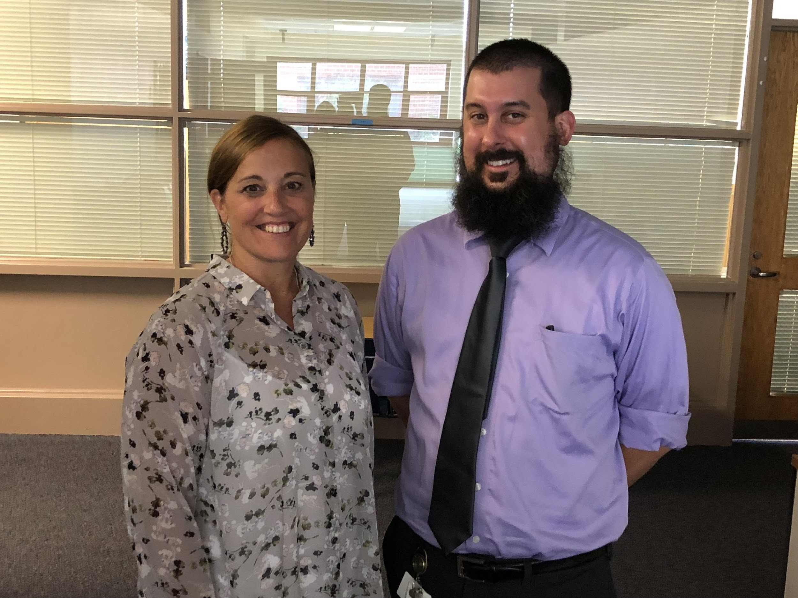
The HCPSS
Gifted & Talented
Education Program
G/T Math
September 18, 2019
5:30 – 6:00 p.m.
Notes:
1

Slide 2
Number Routine Over/Under
$\frac{5}{8}$ + $\frac{2}{4}$ over/under 1
$\frac{1}{3}$ + $\frac{2}{6}$ over/under 1
1 $\frac{5}{10}$ + $\frac{2}{3}$ over/under 2
2 $\frac{2}{4}$ + 2 $\frac{4}{10}$ over/under 5

Slide 3
G/T Math Curriculum
Common Core = mastery curriculum. The concepts studied will not be explicitly taught again, but students will be expected to apply them to future problem solving situations they encounter. Extension of CC meets the needs of students for when they enter Algebra 1 in 7th grade.
Emphasis on advanced level problem solving. Concepts are extended and applied through problem solving tasks with increased depth, complexity, and acceleration.
Unit format. Within each unit, concepts are taught, practice is given, and students are assessed using tasks, projects, tests, and teacher observation based upon student performance during instruction.
Notes:
Students develop a depth of understanding and ability to apply mathematics to real-life situations, In prekindergarten through grade 8 mathematics, the standards lay a solid foundation in whole numbers, addition, subtraction, multiplication, division, fractions, and decimals. These elements support a student’s ability to learn and apply more demanding mathematics concepts and procedures in middle and high school.

Slide 4
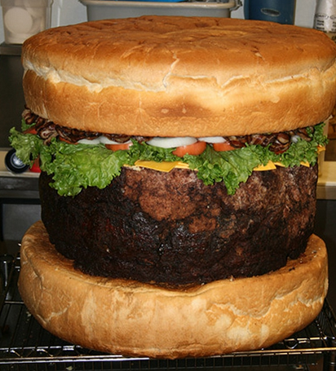
The Largest Hamburger Ever?
The burger started out weighing 270 pounds and ended up weighing 180 pounds after cooking.
I have consumed burgers that weighed one pound before cooking.
Assuming the weight of the original beef, beef that becomes grease and final burger weight are proportional, what part of the original one-pound burger should remain after cooking?
If the restaurant wants to have a 400-pound patty after it has been cooked, what weight should they start out with?
It takes 20 hours to bake 270 pounds of hamburger and eight hours to cool it in a freezer.
I only have 5 hours to bake my hamburger.
Approximately how many pounds of hamburger will I be able to bake in that time period if it is proportional to the original hamburger?

Slide 5
The Standards for Mathematical Practices
Make sense of problems and persevere in solving them
Reason abstractly and quantitatively
Construct viable arguments and critique the reasoning of others
Model with mathematics
Use appropriate tools strategically
Attend to precision
Look for and make use of structure
Look for and express regularity in repeated reasoning
Notes:
A integral aspect of our math program is helping students learn to identify and employ the standards for mathematical practices.
As part of the Common Core Curriculum, students develop these practices through grade 12. But I might argue that if you have a job that involves mathematics, you are using these practices still.
These practices ensure that students are actually USING mathematics, not just learning math facts or procedural steps or crunching numbers with an algorithm out of context.

Slide 6
Learn How Elementary Mathematics Fosters an Environment for Intellectual Growth
Math Video

Slide 7
How Students are Assessed
Teacher-made tests and quizzes
Problem Solving Tasks
Demonstration of the Mathematical Practices through teacher observation
Completed projects
Participation in class
discussions
Notes:
We are always assessing our students, to some extent, because assessment drives instruction. Here are some of the different ways we collect data on student performance.

Slide 8
Grading
Students expected to maintain at least a C average
Grades are averaged from a variety of activities: quizzes, assessments, classwork, projects, discussions, presentations, teacher observation
Grading Breakdown
Concepts | 50% CW -- 50% Assessments
Problem Solving | 50% CW -- 50% Problem Solving Tasks
A (90-100%), B (80-89%), C (70-79%), D (60-69%), E (0-59%)
Notes:
Grading policy was sent home and will be left in your child’s binder for reference.

Slide 9
Homework
Homework can be assigned Monday through Thursday (Students check their own homework in class and take it home the same day.)
Students will keep track of their own homework completion
Please allow your child to follow the “30 Minute Rule” for homework
Homework will be posted on the Canvas assignments section. Student is responsible for recording homework in agenda book daily.
Homework Buddy/Goal of Autonomy
Notes:
Homework is not intended to be a source of stress. It’s almost always review of a topic students have already learned.
If, for some reason your child has spent 30 minutes on their homework and it’s still not complete please jot down a quick note and let them stop. If HW is taking longer than 30 minutes, that lets the teacher know that student needs some support or reteaching in that area.

Slide 10
Problem Solving
PROBLEM SOLVING TASK
A word problem will be given 2 times a quarter.
Emphasis on effective written communication
Families are welcome to help the student unpack their thinking and offer strategy ideas, but the goal is that the solution comes from the student.
OLYMPIADS:
Before School Math Club - (Grades 4 and 5 Only)
Will meet on select Thursdays from 7:50 - 8:30 am November - March.
Celebration will be held on June 11th
Fee for participation, some scholarships will be made available.
Look for flier and notice in the Hollifield Herald
Notes:
Created in 1977 by Dr. George Lenchner, an internationally known math educator, the Math Olympiads went public in 1979. Last year nearly 170,000 students from 6,000 teams worldwide participated in the Olympiads. All 50 states and about 30 other countries were represented. Goal: To stimulate enthusiasm and a love for mathematics, to introduce important mathematical concepts, teach major problem solving strategies to strengthen flexibility and creativity in solving problems

Slide 11
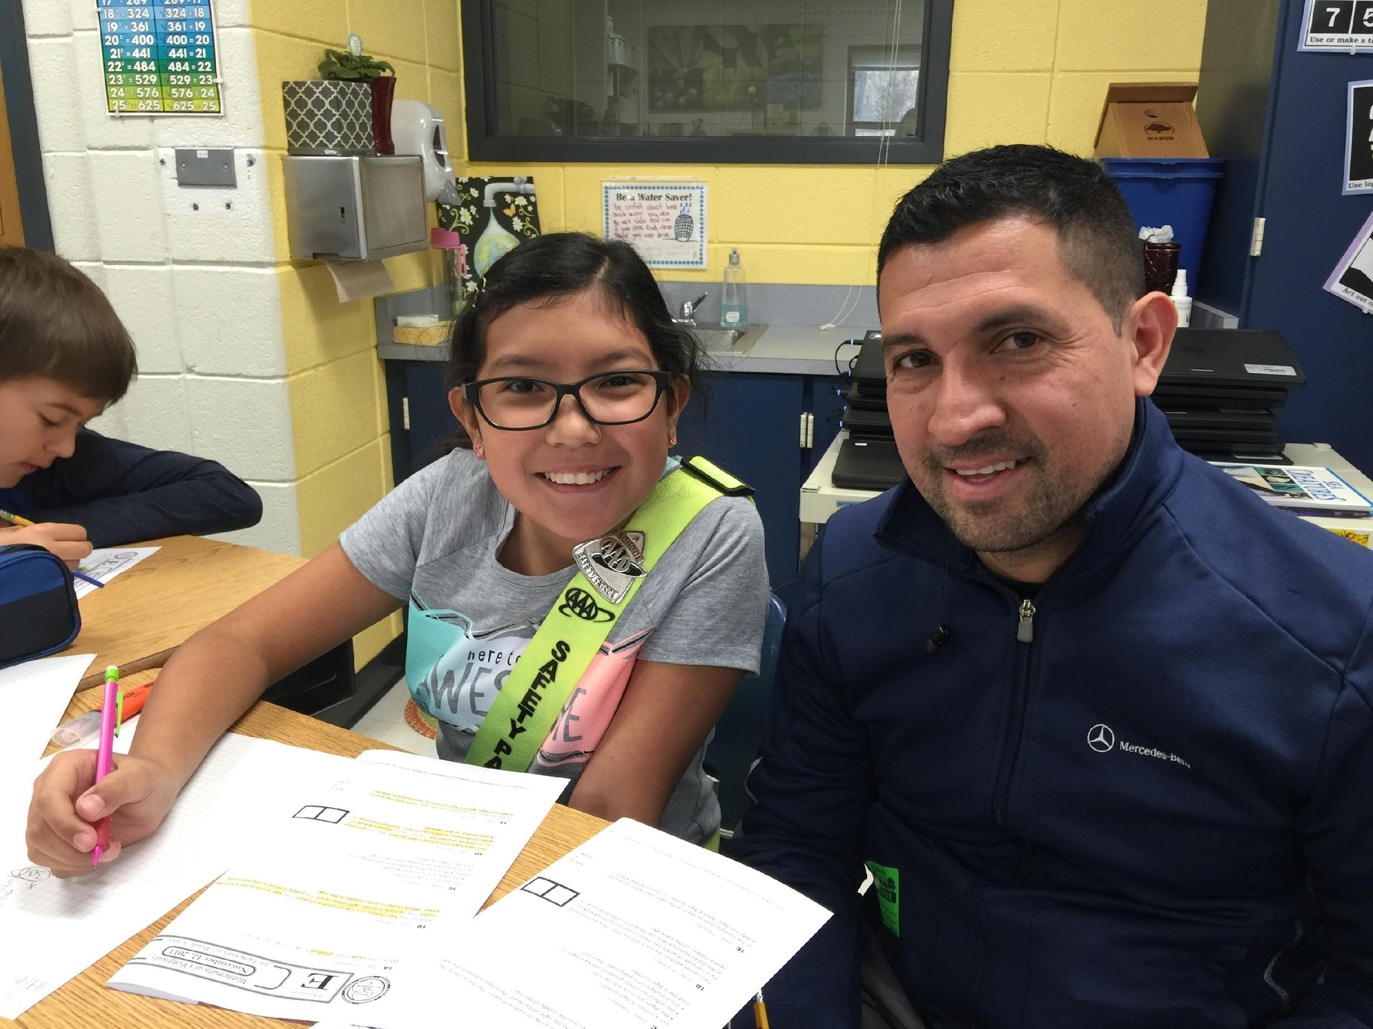
American Education Week
Monday, November 18th
Come join us for a problem solving task.
Grade 5 8:50 - 10:05 am
Grade 4 1:50 - 3:05 pm
Notes:
This could be you!!! We would love for you to join us November 18th

Slide 12
Absences
Students are responsible for any missed work. They will have an equal number of days as the absence to complete the assignment(s). Failure to hand in work on time will be marked as “late” and will result in a lower score by one letter grade.

Slide 13
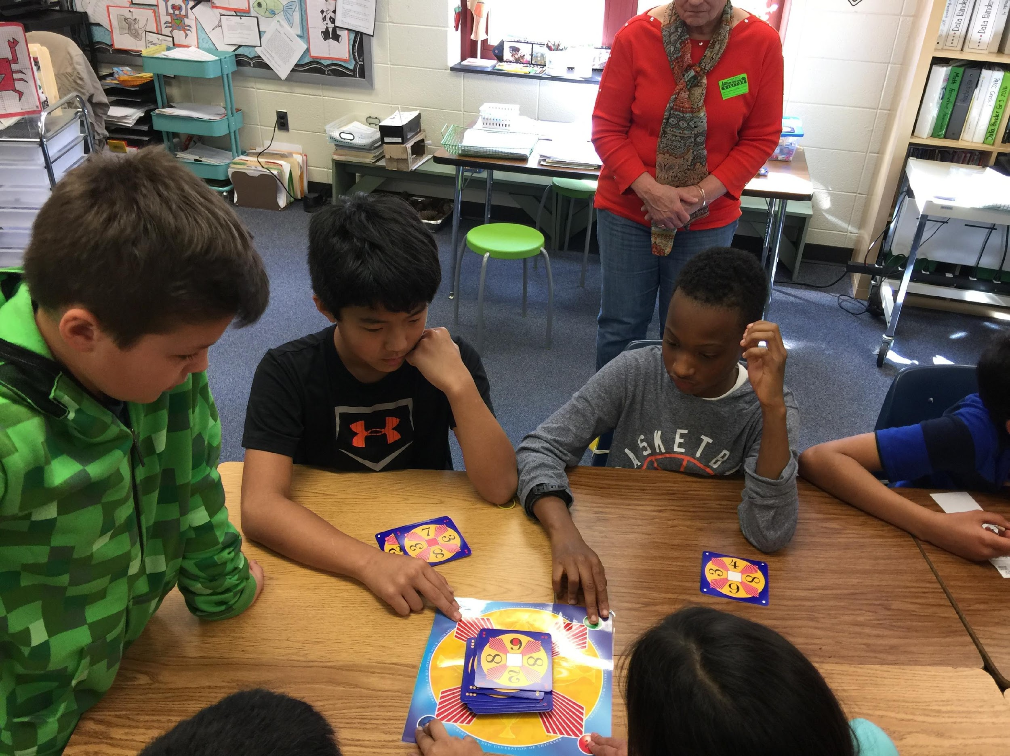
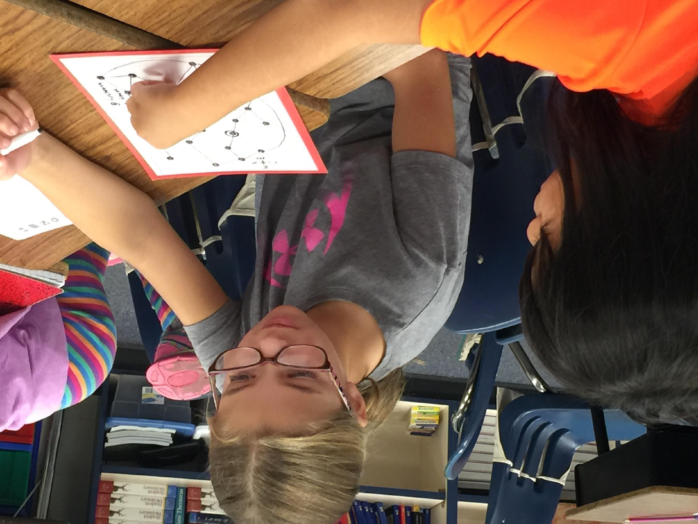
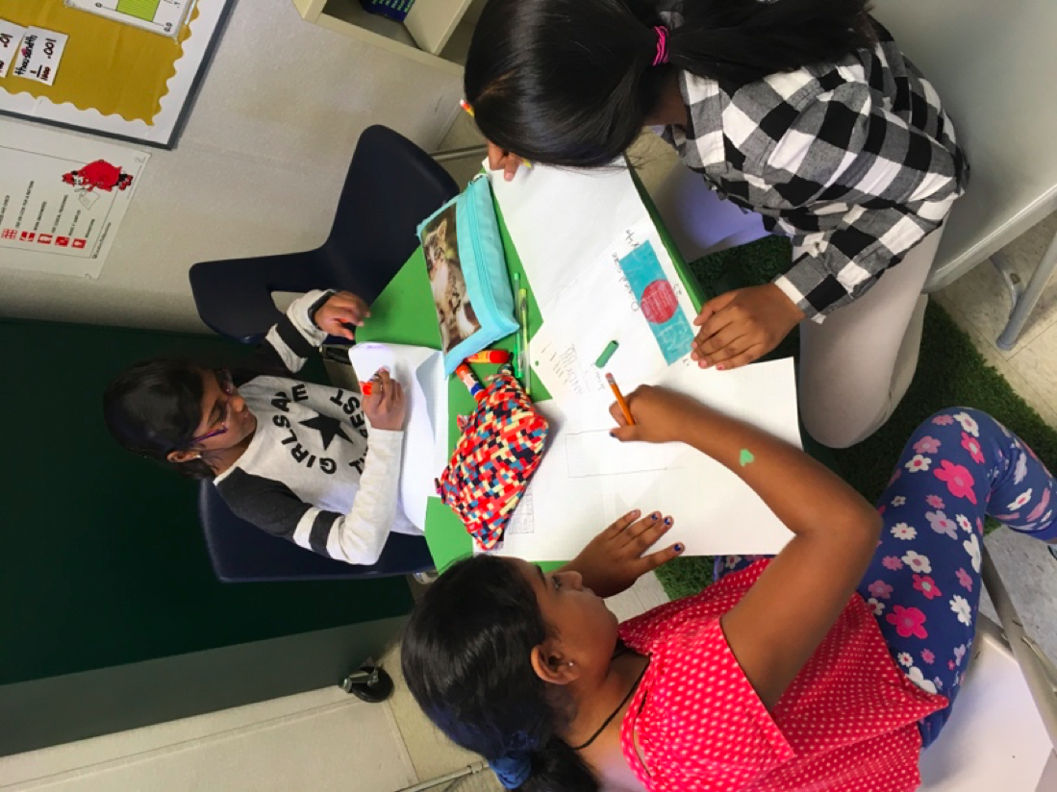
Questions?
Contact us by email:
Lori_Speelman@hcpss.org
Timothy_Bayne@hcpss.org

